Slide 1

Game Theoretic Scheduling
Real Time Task Scheduling In Cloud Computing
Neaz Mahmud

Slide 2
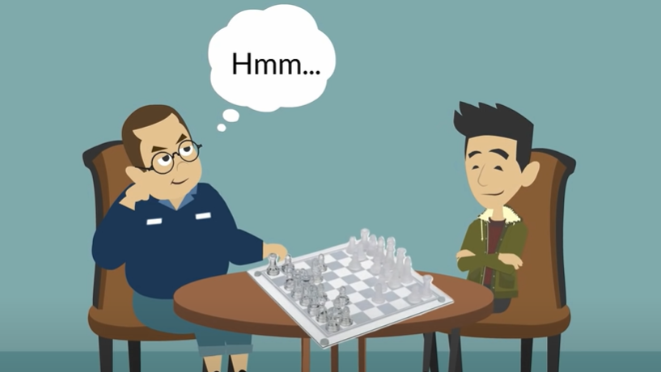
Source : https://www.youtube.com/watch?v=YueJukoFBMU&ab_channel=OneMinuteEconomics

Slide 3



Co-operative
Non Co-operative

Slide 4
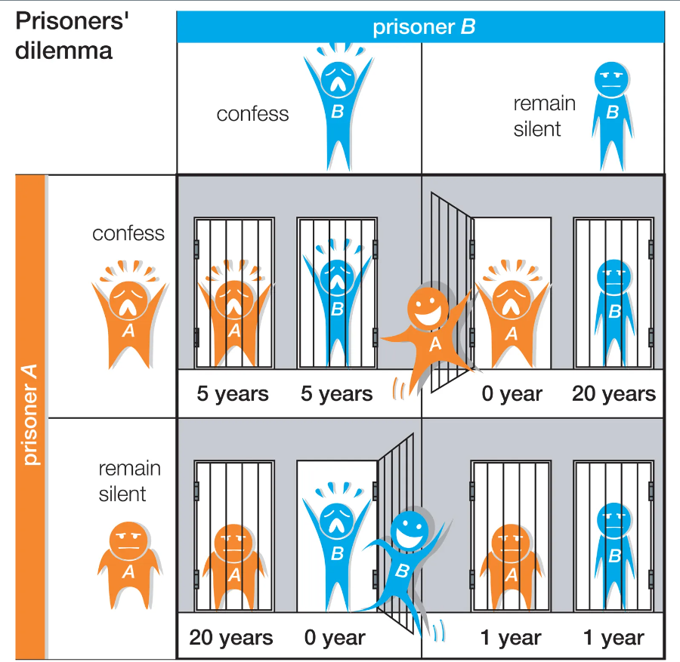
https://cdn.britannica.com/55/91955-050-F444D10D/dilemma-prisoners-participants-game-theory-communication-strategy.jpg

Slide 5


Cloud Computing

Slide 6
System Model
Virtual Machine Model
Task Model
Scheduling Model

Slide 7
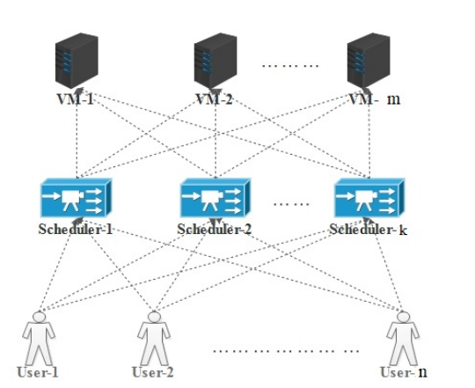
System Model

Slide 8
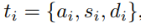
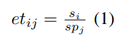
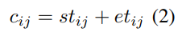
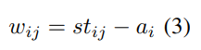
Virtual Machine Model
Task Model
V = {v1, v2, . . . , vm}
j = {1, 2, . . . , m}.
Million Instructions Per Second (MIPS)

Slide 9
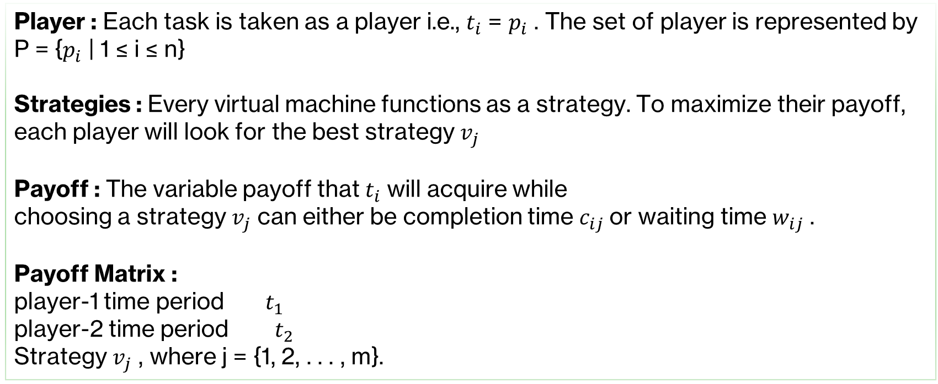
Player : Each task is taken as a player i.e., $t_{i}$ = $p_{i}$ . The set of player is represented by P = {$p_{i}$ | 1 ≤ i ≤ n}
Strategies : Every virtual machine functions as a strategy. To maximize their payoff, each player will look for the best strategy $v_{j}$
Payoff : The variable payoff that $t_{i}$ will acquire while
choosing a strategy $v_{j}$ can either be completion time $c_{ij}$or waiting time $w_{ij}$ .
Payoff Matrix :
player-1 time period ${ t}_{1}$
player-2 time period $t_{2}$
Strategy $v_{j}$ , where j = {1, 2, . . . , m}.

Slide 10
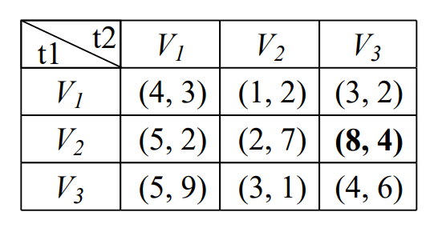
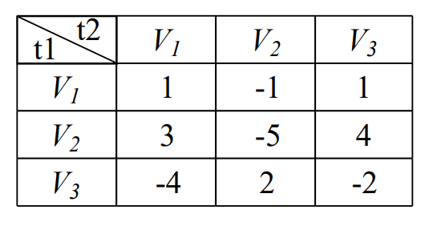
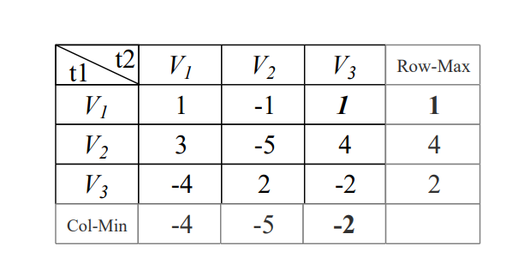
Non Co Operative
PayOff Matrix
Normalised PayOff Matrix
VM Selection

Slide 11
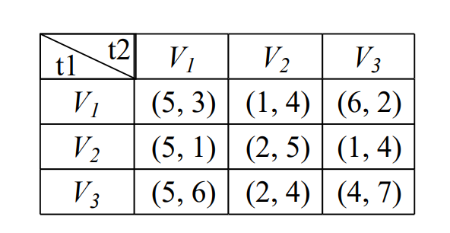
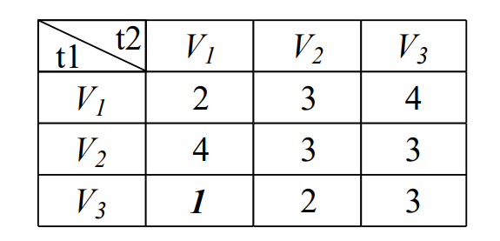
Co-Operative
PayOff Matrix
Normalised PayOff Matrix

Slide 12
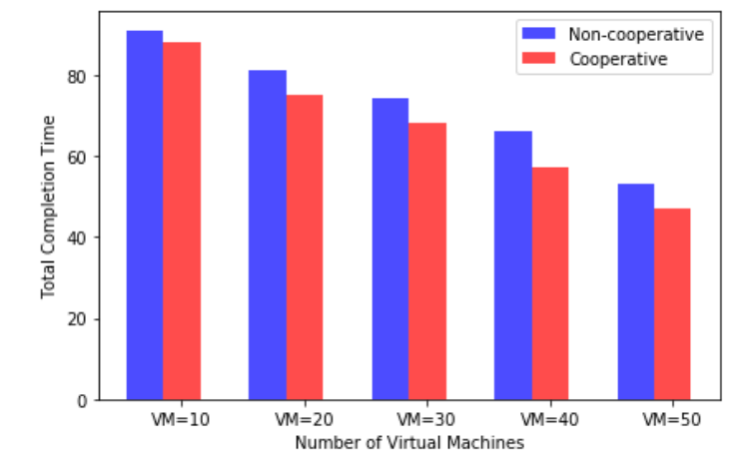
Completion Time as PayOff

Slide 13
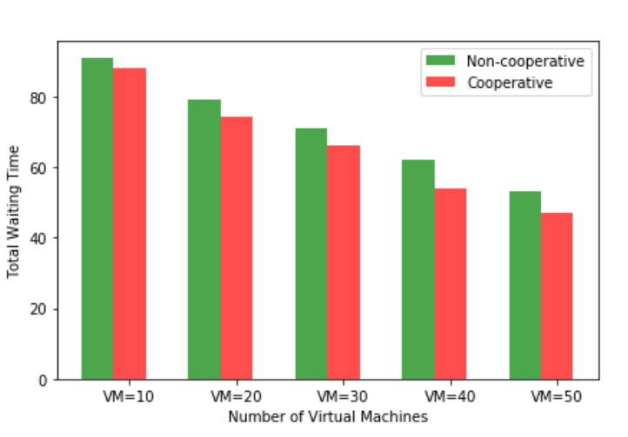
Waiting Time as PayOff

Slide 14

Take Away

